Slide 1
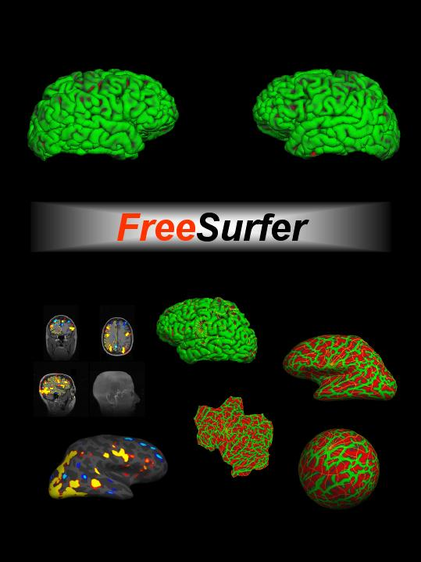
Multimodal Integration surfer.nmr.mgh.harvard.edu

Slide 2
Overview
Affine transformations
Registration, Automatic and Manual
fMRI Integration
  fMRI Analysis Intro
  Registration
  Viewing on Volume and Surface
  ROI analyses
  Surface-based group analysis

Slide 3
Theory of Affine Spatial Transforms
Anatomical (1x1x1.1mm, 256x256x128, Sag)
Scanner Acquisition
Functional (3x3x5mm, 64x64x30, Axial)

Slide 4
Theory of Affine Spatial Transforms
Native Anatomical Space 1x1x1.1mm, 256x256x128, Sag
Conformed Anatomical Space 1x1x1mm, 256x256x256, Cor
“Anatomical Space”
orig.mgz
Surfaces
Parcellations
Segmentations

Slide 5
Theory of Affine Spatial Transforms
“Anatomical Space”
Native Functional Space 3x3x5mm, 64x64x30, Axial
???
Conformed Anatomical Space 1x1x1mm, 256x256x256, Cor

Slide 6
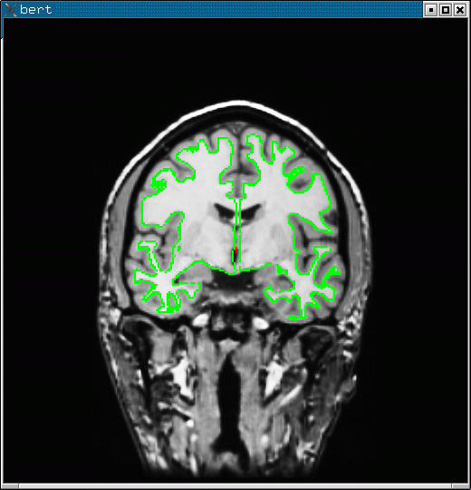
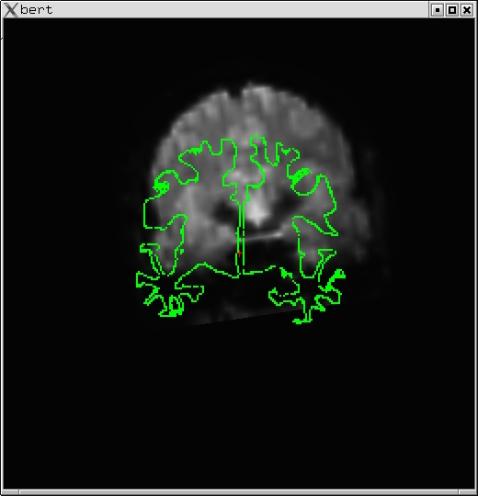
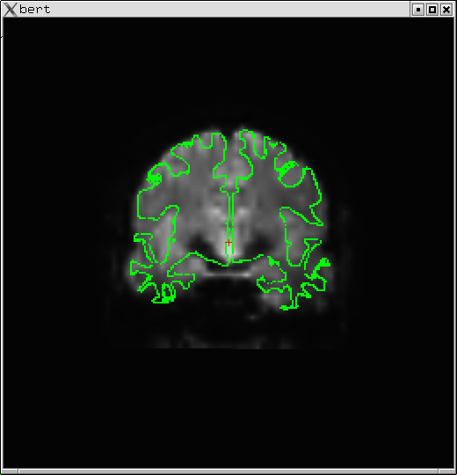
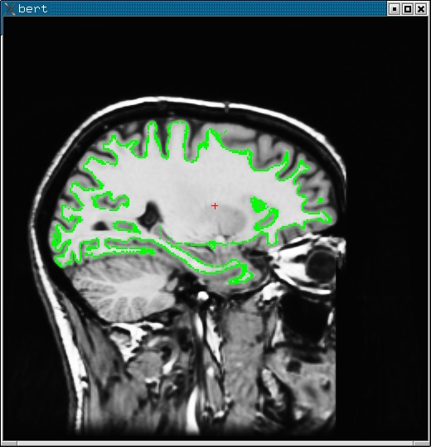
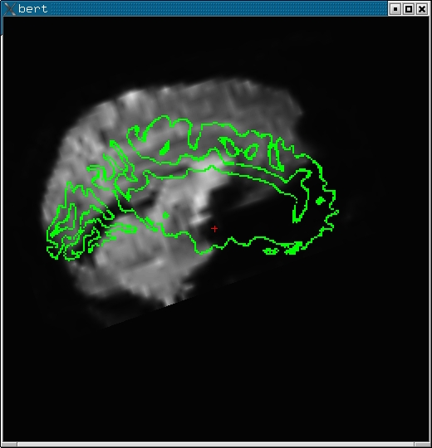
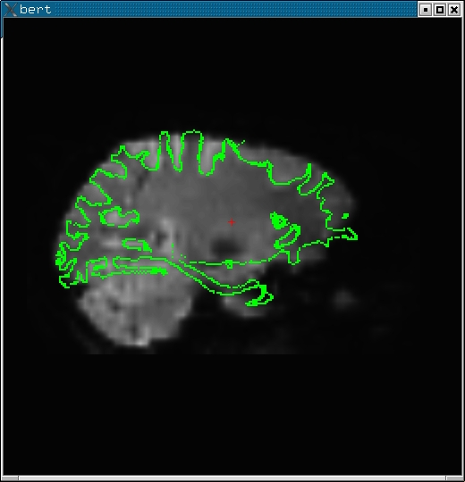
Registration
FreeSurfer Anatomical (orig)
Template Functional
Note: Registering the template functional volume to the anatomical volume
is sufficient to register the template to the surface.

Slide 7
FreeSurfer Registration and
Template Volume
FreeSurfer
Subject-Specific
  Volumes
  Surfaces
  Thickness
  ROIs
Template Volume
  fMRI
  DTI
  ASL
  PET
  …
Registration
Template Volume:
In voxel-for-voxel registration with parameter map
Best gray-white contrast

Slide 8
FreeSurfer Registration Matrix
4x4 Matrix
As many as 12 DOF (usually 6)
Simple Text file
Coordinate system not easy to explain
mgh-02407836-v2
3.437500
5.000000
0.150000
9.999985e-01 -1.428481e-03 -8.293565e-04 5.281680e-01
4.641568e-04 -2.388080e-01 9.710670e-01 -4.041043e+01
1.585159e-03 9.710652e-01 2.388064e-01 -1.376212e+00
0 0 0 1
round

Slide 9
FreeSurfer Registration Matrix
4x4 Matrix
As many as 12 DOF (usually 6)
Simple Text file
Coordinate system not easy to explain
mgh-02407836-v2
3.437500
5.000000
0.150000
9.999985e-01 -1.428481e-03 -8.293565e-04 5.281680e-01
4.641568e-04 -2.388080e-01 9.710670e-01 -4.041043e+01
1.585159e-03 9.710652e-01 2.388064e-01 -1.376212e+00
0 0 0 1
round
→ FreeSurfer subject name
→ Functional In-plane resolution mm
→ Functional Between-plane resolution mm
→ Intensity (for visualization)
→ Legacy

Slide 10
Automatic Registration
bbregister \
-–subject bert \
–-mov mmtemplate.nii \
--bold \
--init-fsl \
–-reg register.dat
→ Command name
→ FreeSurfer subject name
→ Multimodal template volume
→ Multimodal contrast
→ Initialize with FSL-FLIRT
→ Output registration file
BB = Boundary-based, about 5 min.
Registers template to conformed anatomical of given subject (bert)
Registration is initialized with FSL-FLIRT
6 DOF
Initialization also with --init-spm and --init-header
About 5 min

Slide 11
Manual Registration
tkregister2 \
–-mov mmtemplate.nii \
–-reg register.dat \
--surfs
→ Command name
→ Multimodal template volume
→ registration file
→ Display white surf
Note similarity to bbregister command
Subject not needed (alread in register.dat file)
tkregister2 --help

Slide 12
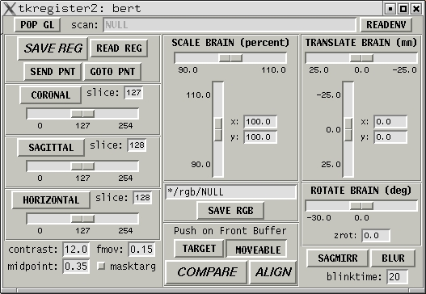
Manual Registration
Visually inspect registration
Manually edit registration (6 DOF)
Cf Manual Talairach registration
Green line is white surface
tkregister2 --help

Slide 13
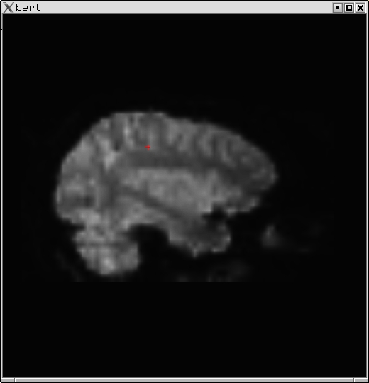
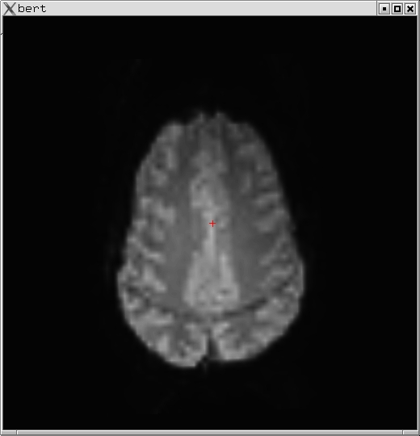
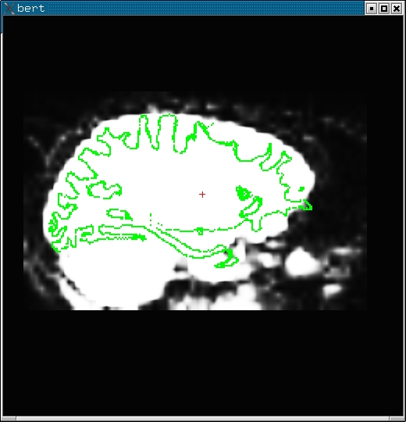
Tips
Rigid = 6 DOF = No stretching
Use CSF to get a sense of where the folds are
Avoid using B0 distortion regions
Avoid using ventricles
Warning about “edge” of the brain
Same Subject, Left-Right Flips

Slide 14
Command-line Tools
Automatic Registration:
  bbregister --help
  fslregister –help
  spmregister –help
  reg-feat2anat –help
Manual Registration:
  tkregister2 --help
Transformations:
  mri_vol2surf --help
  mri_vol2vol --help
  mri_label2vol --help
  mri_surf2vol --help
}
FreeSurfer Scripts

Slide 15
fMRI Integration
Visualize individual fMRI results on
  surface
  volume
ROI Volume Study: Count number of voxels above threshold in an anatomical ROI
ROI Intensity Study: Average HRF inside of an ROI
Surface-based fMRI group analysis

Slide 16
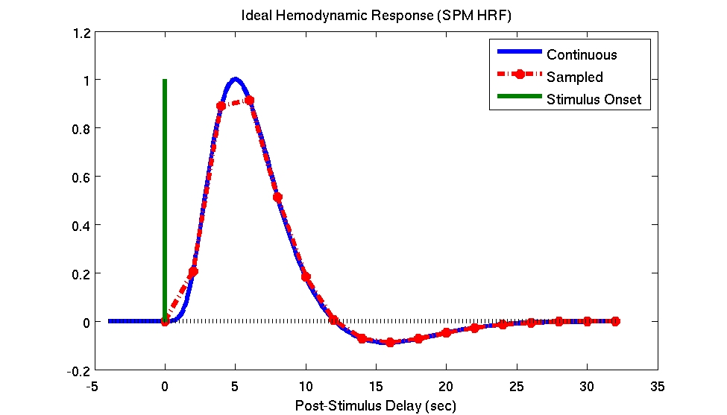
Hemodynamic Response (BOLD)
Time-to-Peak (~6sec)
Dispersion
TR (~2sec)
Equilibrium
(~16-32sec)
Undershoot
Delay (~1-2sec)

Slide 17
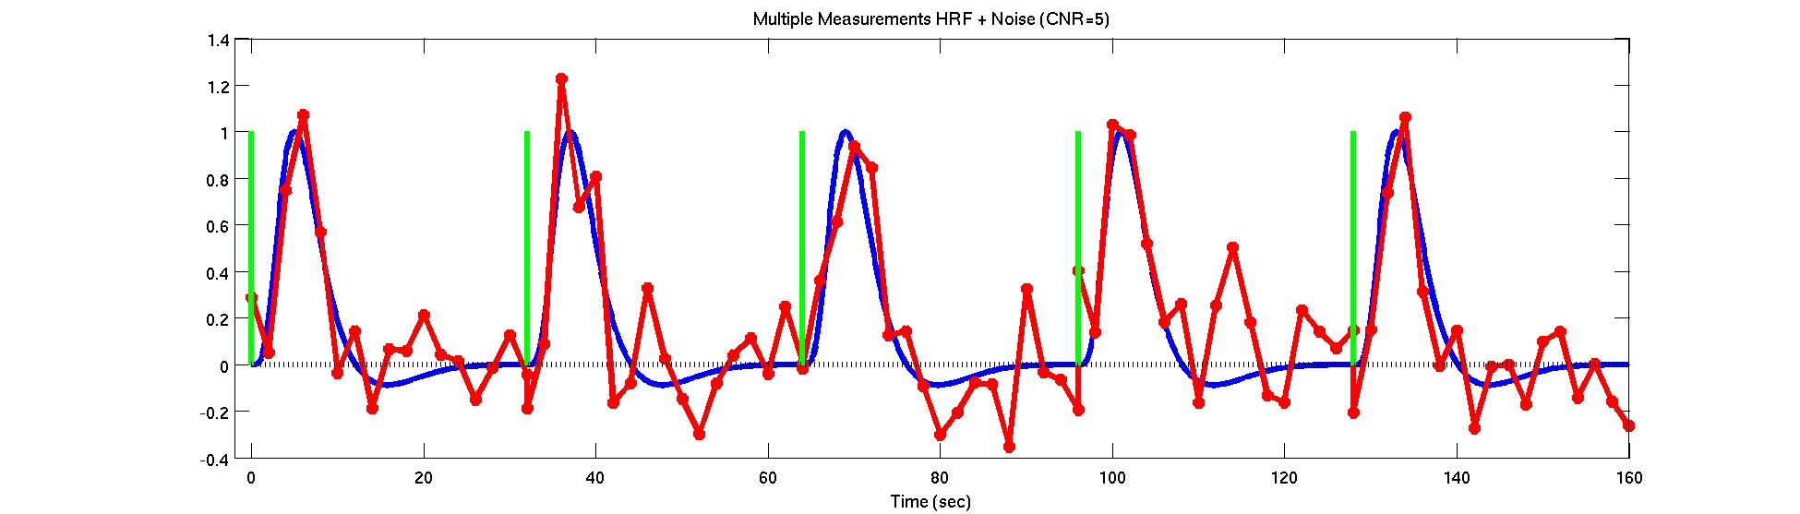
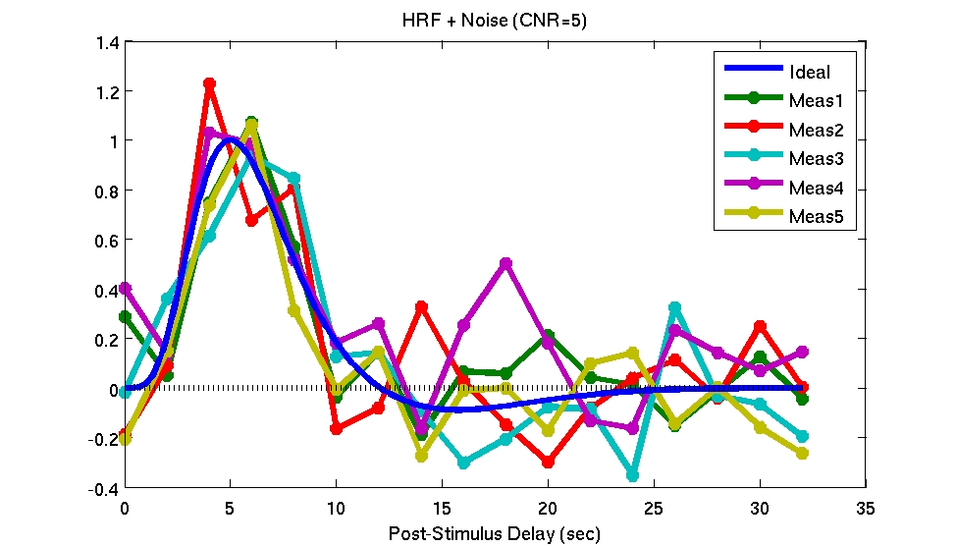
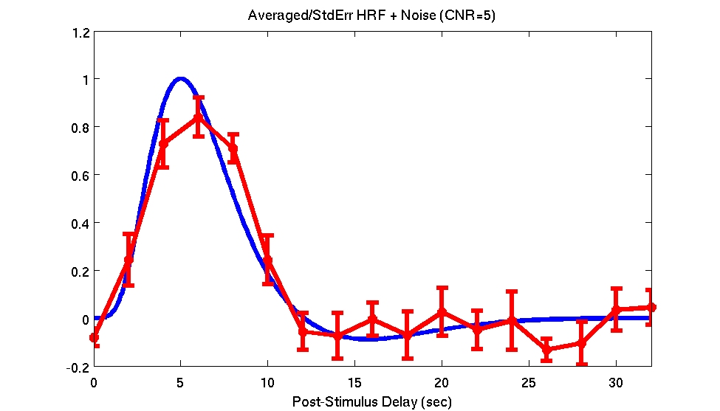
Multiple Presentations/Averaging
Individual Output: HRF Amp, HRF Var, p/z/t/F

Slide 18
fMRI Preprocessing Overview
Motion Correction (MC Template)
  Use for registration template
  bbregister --mov mctemplate.nii --s subject --init-fsl --reg register.dat
  tkregister2 --mov mctemplate.nii --reg register.dat --surf
Do not use nonlinear resampling to talairach/MNI space
Do not spatially smooth (3d)

Slide 19
fMRI Analysis Overview
First-Level (Individual) Analysis
  HRF Amplitude (or Contrast of Amplitudes)
    cope (FSL),
    CON (SPM),
    ces (FSFAST)
  Variance of Amplitude
    varcope (FSL), ??? (SPM), cesvar (FSFAST)
  Activation/Significance Maps:
    z
    t
    F
    sig (-log10(p))
    All in alignment with MC Template!!!!

Slide 20
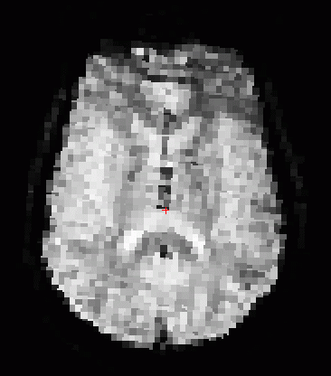
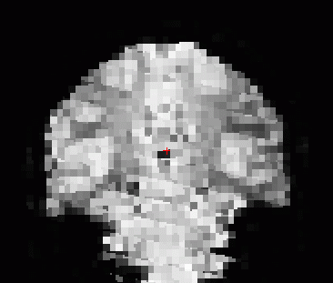
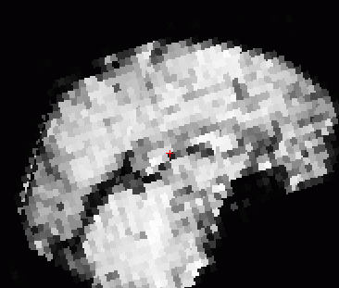
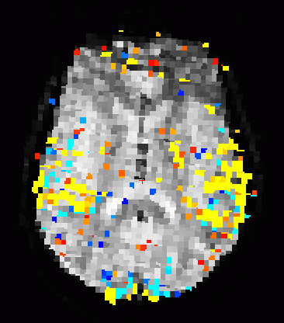
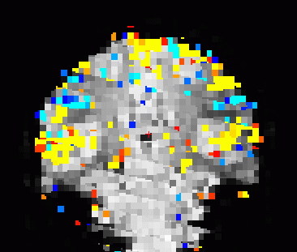
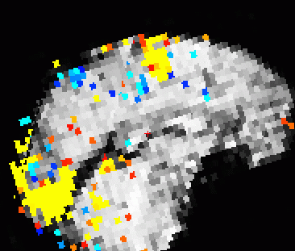
Template and Map
Functional
Template
Template+
Map

Slide 21
Volume Viewing
tkmedit subject orig.mgz –aux brain.mgz –aparc+aseg \
-overlay sig.nii –reg register.dat \
-fthresh 2 –fmax 4
sig.nii – significance map in native functional space. could have been z, t, or F map as well.
register.dat – freesurfer registration file
fthresh – lower threshold (value depends on map). You can change this in the interface.
fmax – saturation threshold. (value depends on map). You can change this in the interface.
aparc+aseg – display aparc+aseg.mgz. Can load this from the interface too.

Slide 22
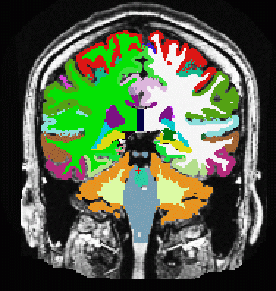
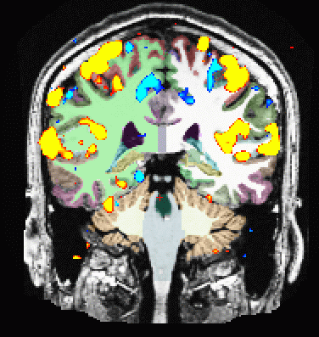
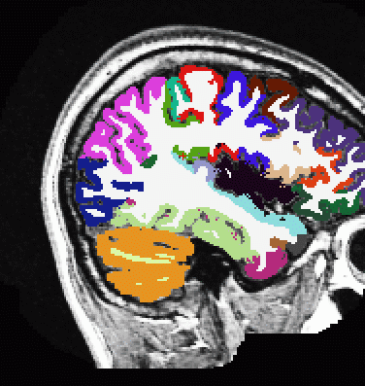
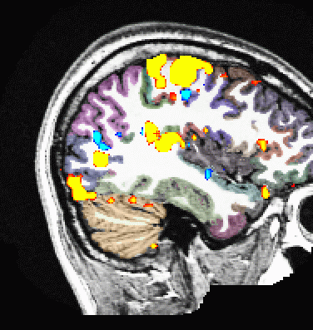
Volume Viewing
Red/Yellow +
Blue/Cyan -
Seg Opacity
ROI Average
ROI Count
Notes:
place holder

Slide 23
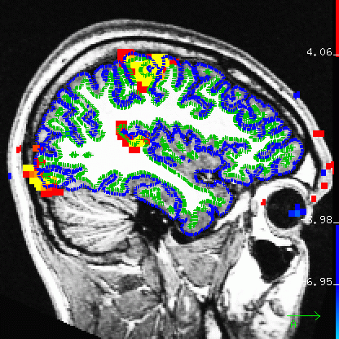
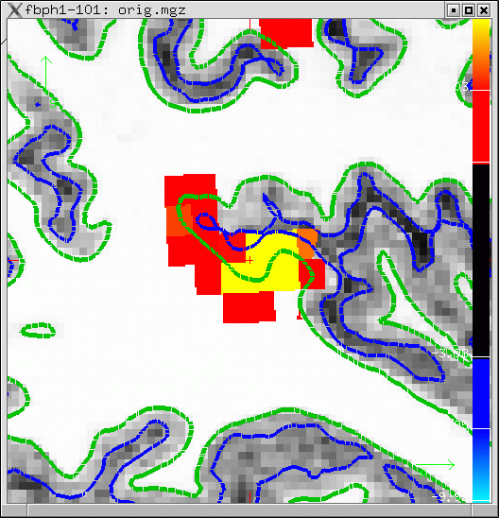
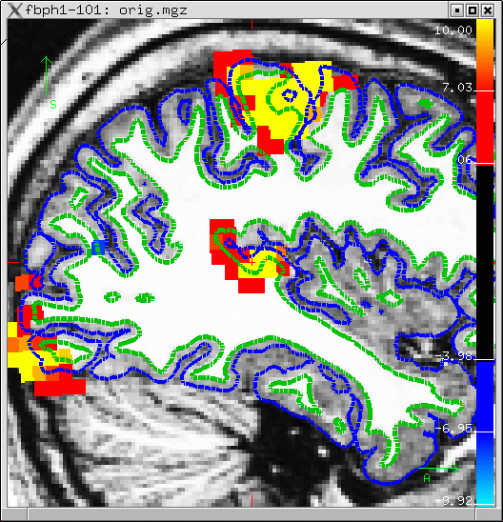
Sampling onto the Surface
Pial
White/Gray

Slide 24
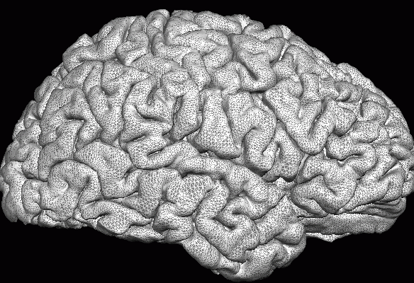
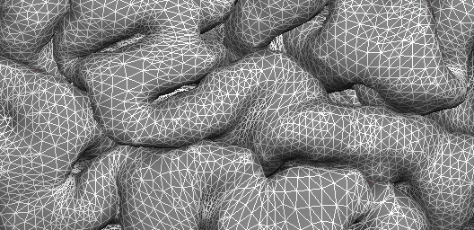
Sampling onto the Surface
Pial
White/Gray
White/Gray
Pial
Half Way
Average
Projection Fraction
--projfrac 0.5

Slide 25
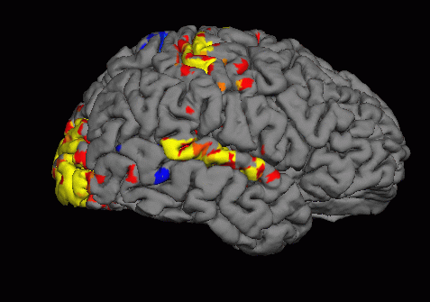
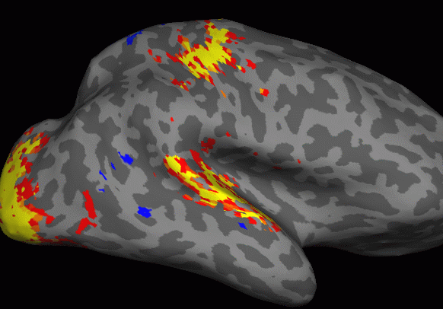
Sampling on the Surface

Slide 26
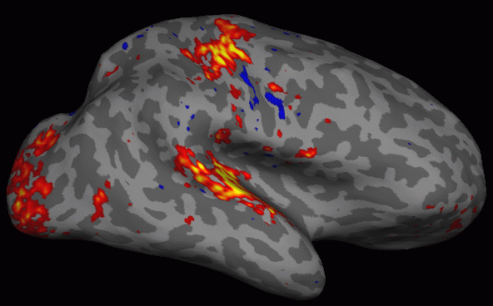
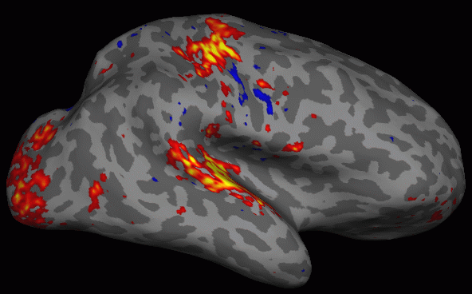
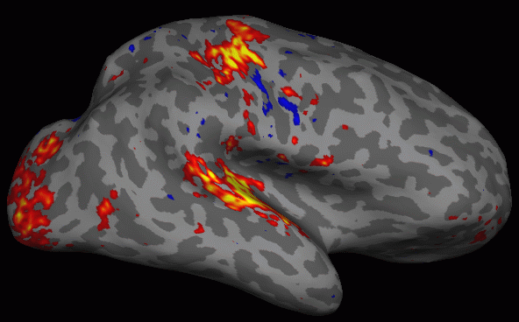
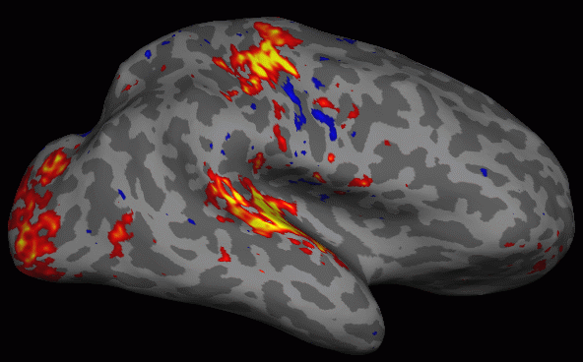
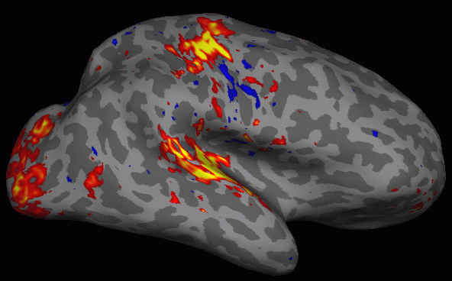

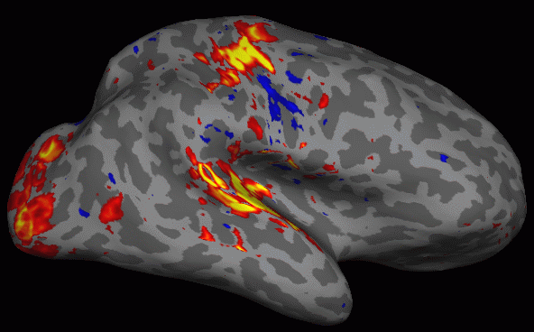
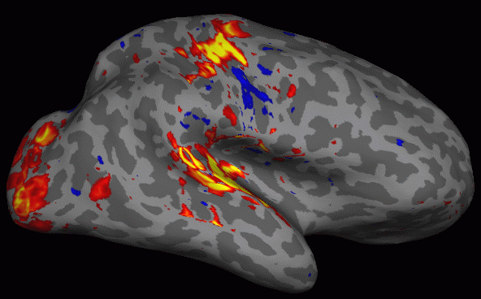

Sampling on the Surface: Projection Fraction
-0.1
0.0 (white)
+0.1
+0.3
+0.5
+0.7
+0.9
+1.0 (pial)
+1.1

Slide 27
Surface Viewing
Resample HRF Contrast Significance to left hemisphere
mri_vol2surf \
--mov sig.nii \
--reg register.dat \
--hemi lh \
--projfrac 0.5 \
--o lh.sig.mgh
→ map in native functional space
→ freesurfer registration file
→ hemisphere
→ projection fraction (half)
→ output (Nvertices-x-1 mgh format)
Note similarity to bbregister and tkregister2 commands.
Load HRF Contrast Significance as overlay
tksurfer subject lh inflated -aparc –overlay lh.sig.mgh

Slide 28
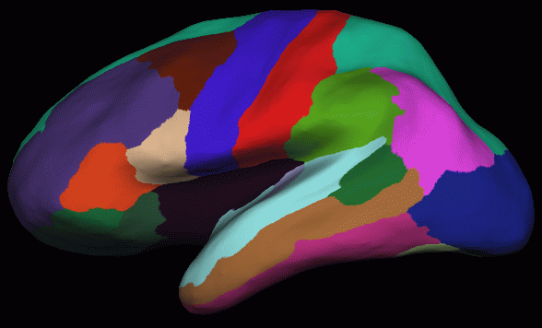
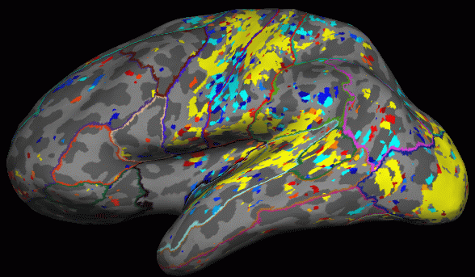
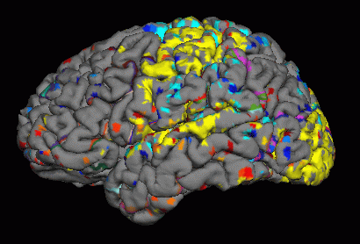
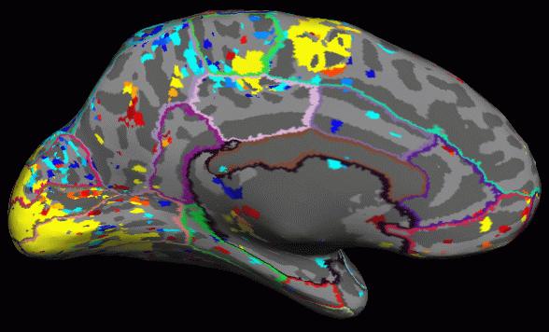
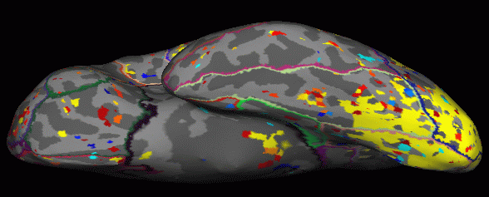
Surface Viewing
Red/Yellow +,Blue/Cyan -
Parcellation Outline
ROI Average
ROI Count

Slide 29
ROI fMRI Analyses:
Intensity
  Full Anatomical ROI
  Functionally Constrained ROI
Volume

Slide 30
Average HRF within Full Anatomical ROI
Eg, average functional HRF amplitudes from all voxels inside of post-central gyrus (red) regardless of whether a voxel is significant or not.
Notes:
Resampling puts ces into voxel-for-voxel registration with aseg.mgz

Slide 31
Average HRF within Full Anatomical ROI
Resample HRF Contrast to anatomical space
mri_vol2vol \
--mov ces.nii \
--reg register.dat \
--interp nearest \
--fstarg \
--o ces.anat.mgh
→ Command name
→ HRF map in functional space
→ FreeSurfer Registration File
→ Nearest neighbor interpolation
→ Specify anatomical output space
→ Output file in anatomical space
Note similarity to bbregister, tkregister2, and mri_vol2surf commands.
Average HRF Contrast within ROIs
mri_segstats \
--seg $SUBJECTS_DIR/subject/mri/aseg.mgz \
--ctab $FREESURFER_HOME/FreeSurferColorLUT.txt \
--i ces.anat.mgh --sum ces.aseg.stats
Notes:
Resampling puts ces into voxel-for-voxel registration with aseg.mgz

Slide 32
Average HRF within Full Anatomical ROI
Average HRF Contrast within ROIs
mri_segstats \
--seg $SUBJECTS_DIR/subject/mri/aseg.mgz \
--ctab $FREESURFER_HOME/FreeSurferColorLUT.txt \
--i ces.anat.mgh --sum ces.aseg.stats
Notes:
--seg is the segmentation (eg, aseg.mgz, aparc+aseg.mgz, etc)
--ctab is matching color lookup table
Output File: ces.aseg.stats
simple text file with same format aseg.stats
multiple subjects can be combined with asegstats2table

Slide 33
Average HRF within a Functionally Active area inside of an Anatomical ROI
Eg, average functional HRF amplitudes from voxels inside of post-central gyrus (red) for voxels that have
p<.01 (sig>2) regardless of sign (yellow or blue), or
p<.01 (sig>2) for positive activation (yellow only), or
p<.01 (sig>2) for negative activation (blue only)
Notes:
Resampling puts ces into voxel-for-voxel registration with aseg.mgz

Slide 34
Average HRF only within the Functionally Active Area of an Anatomical ROI, Count Voxels above threshold in each ROI
Resample HRF Contrast Significance to anatomical space
mri_vol2vol \
--mov sig.nii \
--reg register.dat \
--interp nearest \
--fstarg \
--o sig.anat.mgh
Average HRF Contrast within functionally constrained ROIs
mri_segstats \
--seg $SUBJECTS_DIR/subject/mri/aseg.mgz \
--ctab $FREESURFER_HOME/FreeSurferColorLUT.txt \
--i ces.anat.mgh --sum ces.aseg.mask.stats \
--mask sig.anat.mgh --mask-thresh 2 --mask-sign abs

Slide 35
Average HRF only within the Functionally Active Area of an Anatomical ROI, Count Voxels above threshold in each ROI
mri_segstats \
--seg $SUBJECTS_DIR/subject/mri/aseg.mgz \
--ctab $FREESURFER_HOME/FreeSurferColorLUT.txt \
--i ces.anat.mgh --sum ces.aseg.mask.stats \
--mask sig.anat.mgh --mask-thresh 2 --mask-sign abs
Volume in stats file is volume above threshold (may be 0)
Sign is important for Average!
  abs, pos, or neg
  pos will always result in positive HRF average
  neg will always result in negative HRF average
  abs ????
Careful to avoid circularity
  Can use a different contrast to mask

Slide 36
Surface-based Group Analysis
mris_preproc \
--hemi lh \
--o lh.fsaverage.ces.mgh \
--iv subject1/ces.nii subject1func/register.dat \
--iv subject2/ces.nii subject2func/register.dat \
--iv subject3/ces.nii subject3func/register.dat \
...
After that, everything else is the same as a thickness study …
mris_fwhm --i lh.fsaverage.ces.mgh --fwhm 10 \
--o lh.fsaverage.ces.sm10.mgh --cortex
mri_glmfit --surf fsaverage lh –cortex \
--y lh.fsaverage.ces.sm10.mgh ...

Slide 37
Summary
Multi/Cross-modal map (HRF Amplitude, FA)
Multimodal Integration requires a Template
A Template is:
  Same size as multimodal map
  In Voxel-to-voxel alignment with map
  Has better anatomical contrast
    Baseline functional
    Low-B DTI
  Usually a MC template
Volume and Intensity ROI Analyses
  Functionally-constrained ROI

Slide 38
Tutorial
Registration – manual and automatic registration
fMRI Integration (Sensorimotor Paradigm)
  Individual
    Volume view sig
    Surface view sig
    ROI analysis with and without functional constraint
  Group
    mris_preproc
    ROI analysis (asegstats2table)

